Slide 1


Week-1 Assignment
By Viswajith PS
12217268

Slide 2

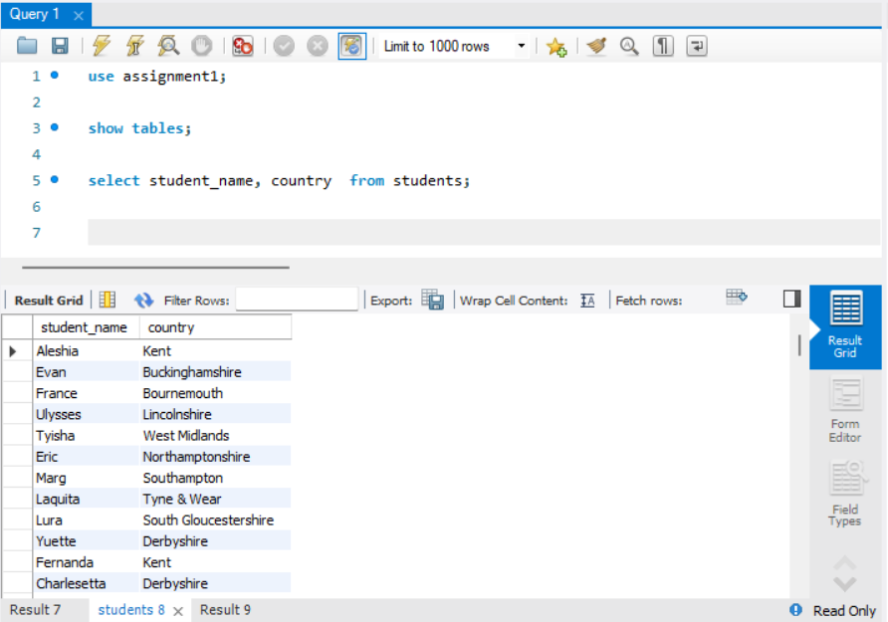
B
SQL Week-1 Assignment
Q1. Return student name and the country they belong to

Slide 3
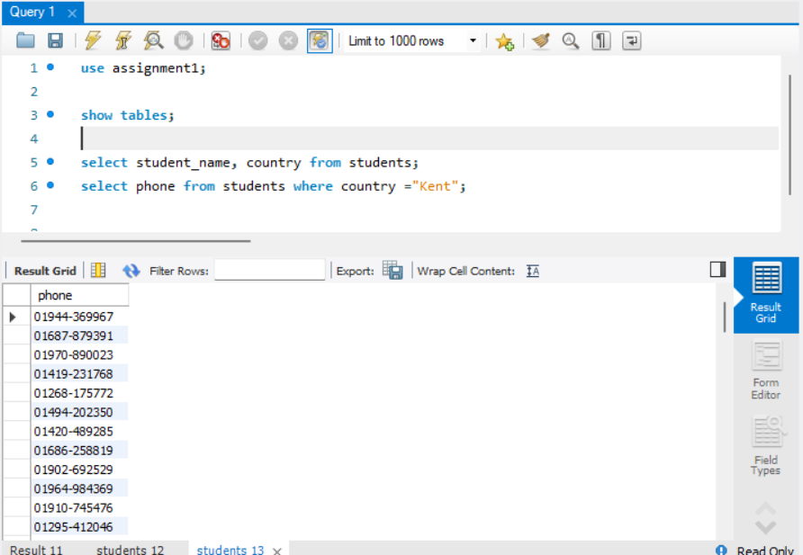
SQL Week-1 Assignment
Q2.List the student’s phone number belonging to the country “Kent”
Notes:
Change layout

Slide 4
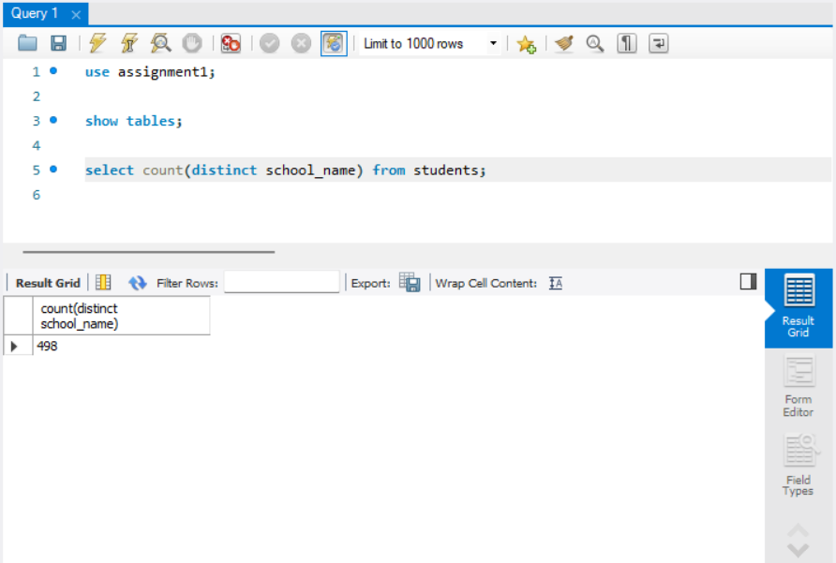
SQL Week-1 Assignment
Q3. How many different schools have participated in this survey?

Slide 5
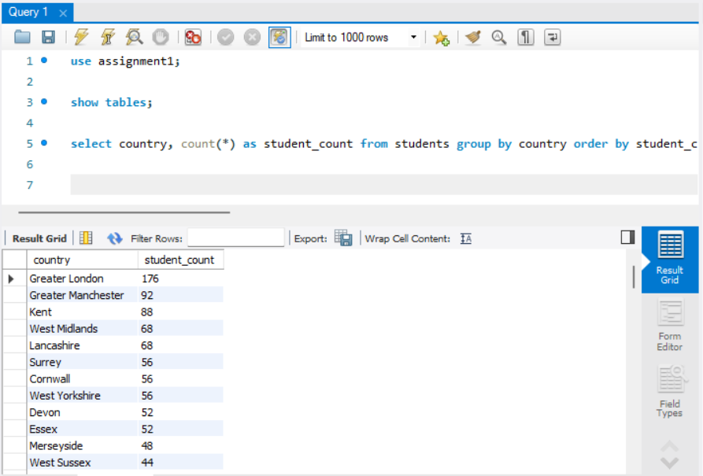
SQL Week-1 Assignment
Q4. Can you group the students country-wise and count the number of students coming from those different countries?
Notes:
breaking, acceleration as behavior

Slide 6
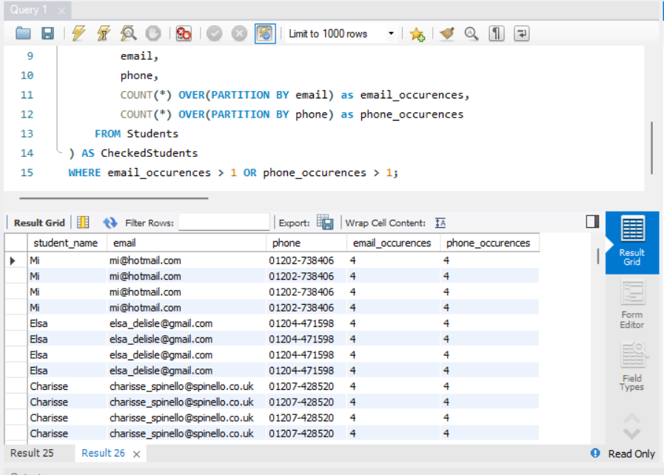
SQL Week-1 Assignment
Q5.Check if Same email/phone mapped to different students

Slide 7
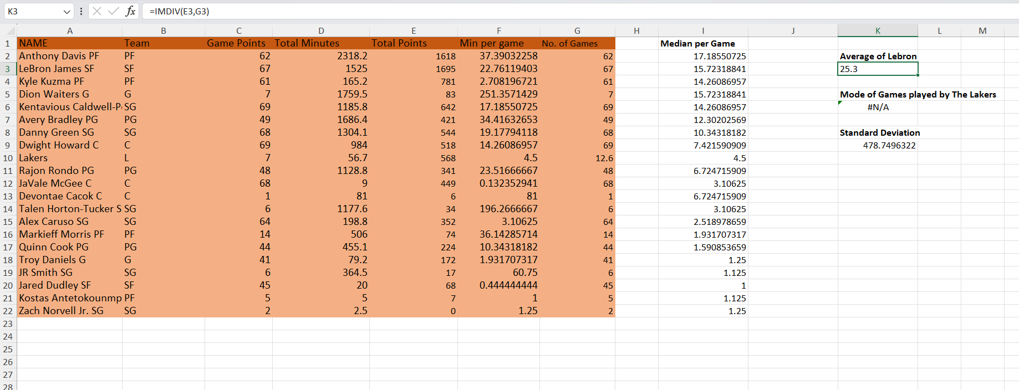
Excel Week-1 Assignment
Q1. Calculate the average points per game for LeBron James.

Slide 8
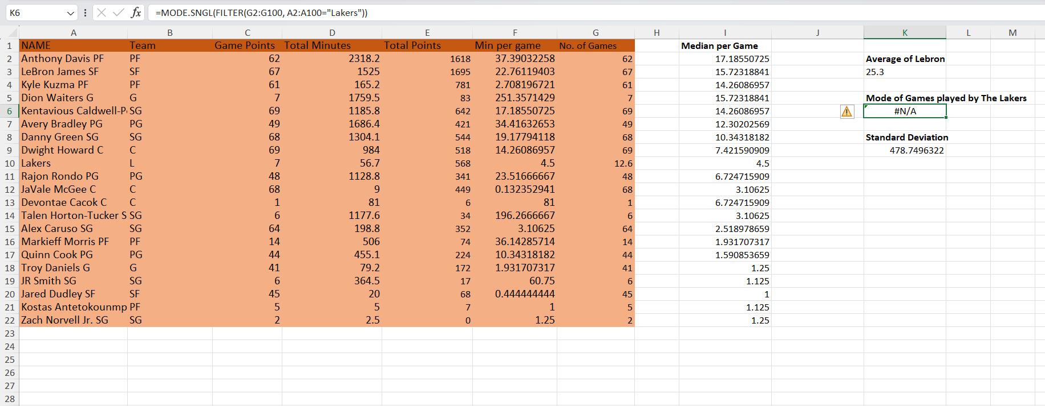
Excel Week-1 Assignment
Q2. What is the mode for the number of games played by the team members on the Lakers?

Slide 9
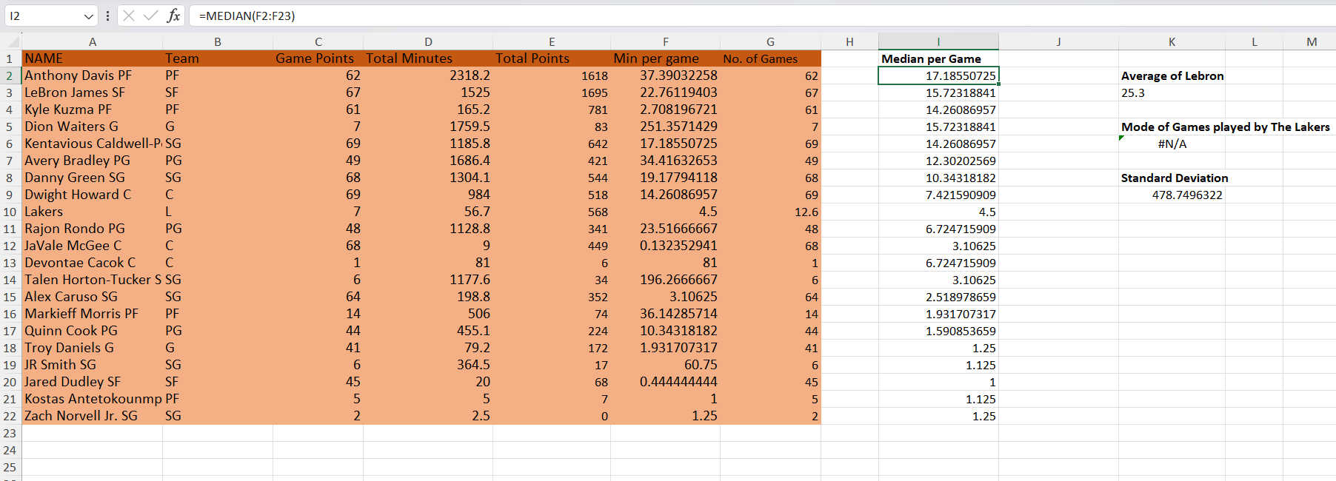
Excel Week-1 Assignment
Q3. Calculate the median minutes per game for these players.

Slide 10
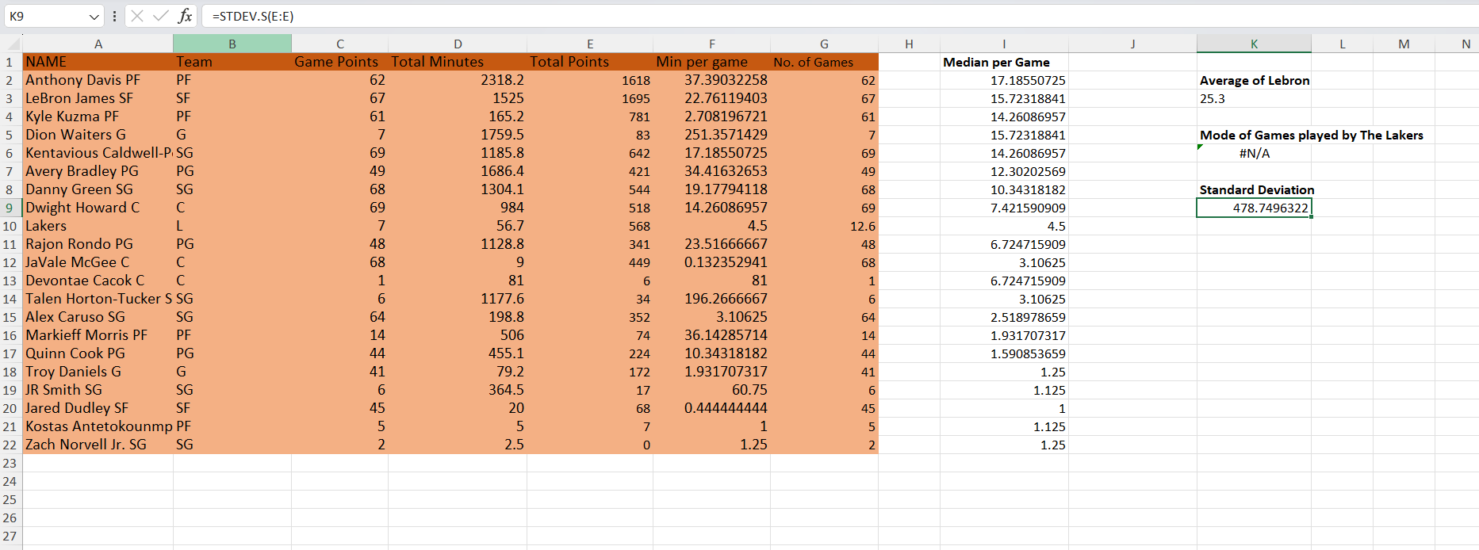
Excel Week-1 Assignment
Q4. Calculate the standard deviation of total points for the entire team.
Notes:
Add images

Slide 11
Excel Week-1 Assignment
Q5. Which is the appropriate measure for the central tendency for the number of minutes per player on this team?
Ans: The median is the most suitable measure of central tendency for minutes per player because the data is skewed by the large gap between starters and bench players, which makes the mean highly sensitive to outliers.

Slide 12
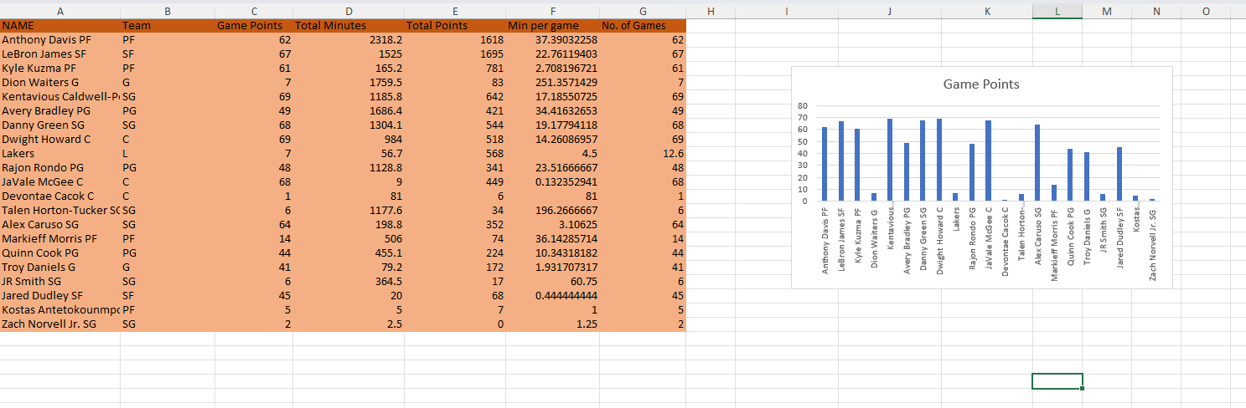
Excel Week-1 Assignment
Q6. Plot the column chart to show every player's game points.
Notes:
Add images

